Slide 1


Design of Real Time Machine Learning Systems
INFO 5502
Analytic Tools, Techniques and Methods
Ravi Varma Kumar Bevara

Slide 2
Agenda
Why Machine Learning? (Introduction)
Types of Machine Learning
Use Cases - Supervised, Unsupervised, Reinforcement
ML research vs. ML production
ML systems vs. traditional software
ML production myths
ML Systems Fundamentals

Slide 3
1. Why Machine Learning? (Introduction)

Slide 4
What is Machine Learning?
Machine learning (ML), a subset of artificial intelligence (AI), is a branch of computational science that focuses on studying and understanding patterns and structures in data to enable learning, reasoning, and decision making without human input.
Simply defined, machine learning allows the user to provide an enormous amount of data to a computer algorithm and have the computer evaluate and make data-driven suggestions and conclusions based only on the input data. If any adjustments are found, the algorithm can use that knowledge to make better decisions in the future.

Slide 5
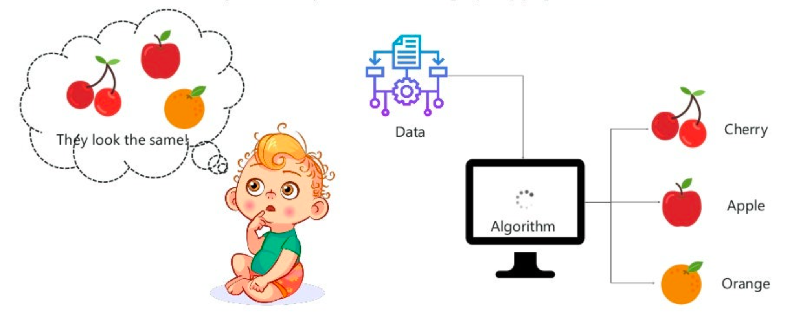

Slide 6
Why Is Machine Learning Important?
All businesses depend on data to function. Making decisions based on data-driven insights might be the difference between staying competitive or falling farther behind. In order to harness the value of corporate and customer data and make decisions that keep a business ahead of the competition, machine learning may be the answer.

Slide 7
2. Types of Machine Learning

Slide 8
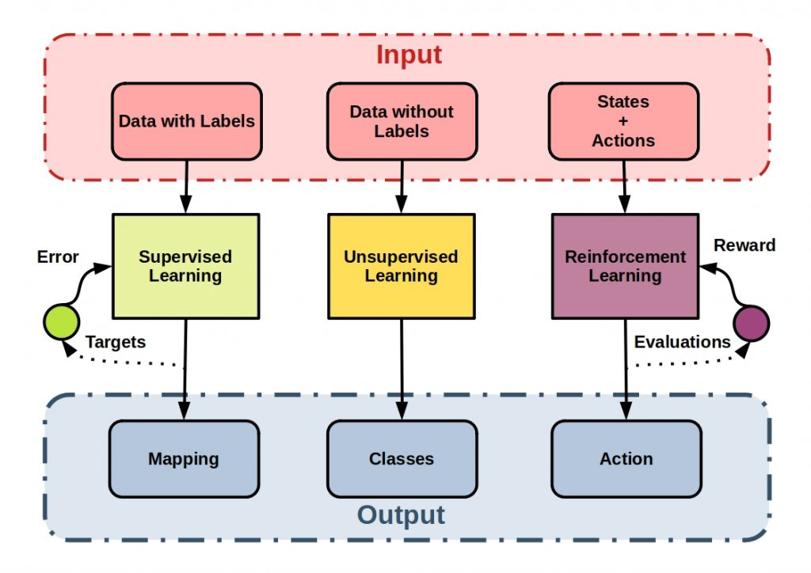

Slide 9
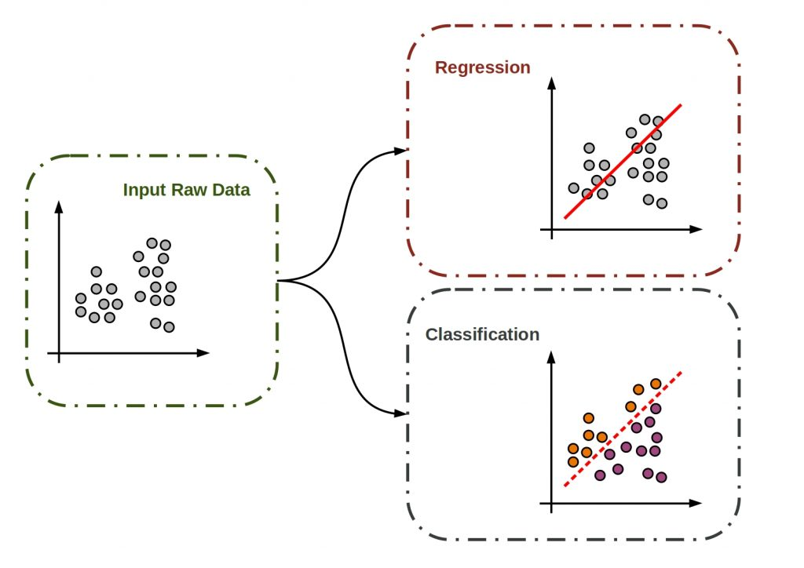
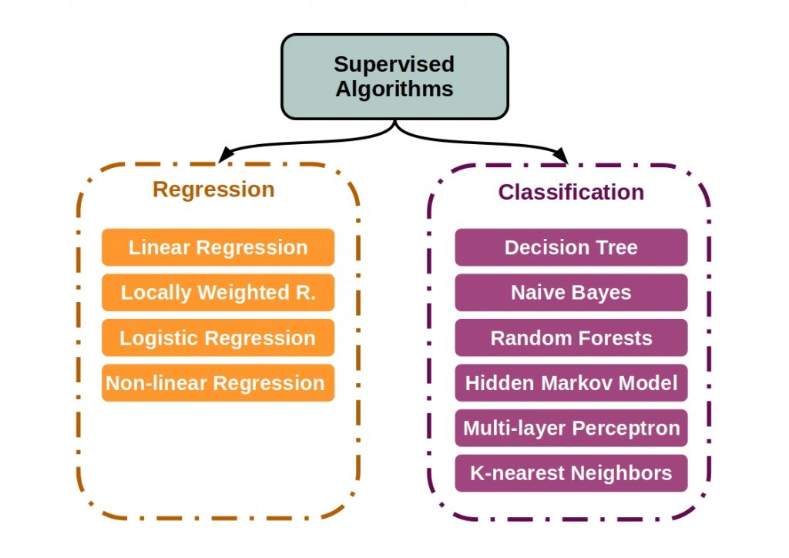
Supervised Learning

Slide 10
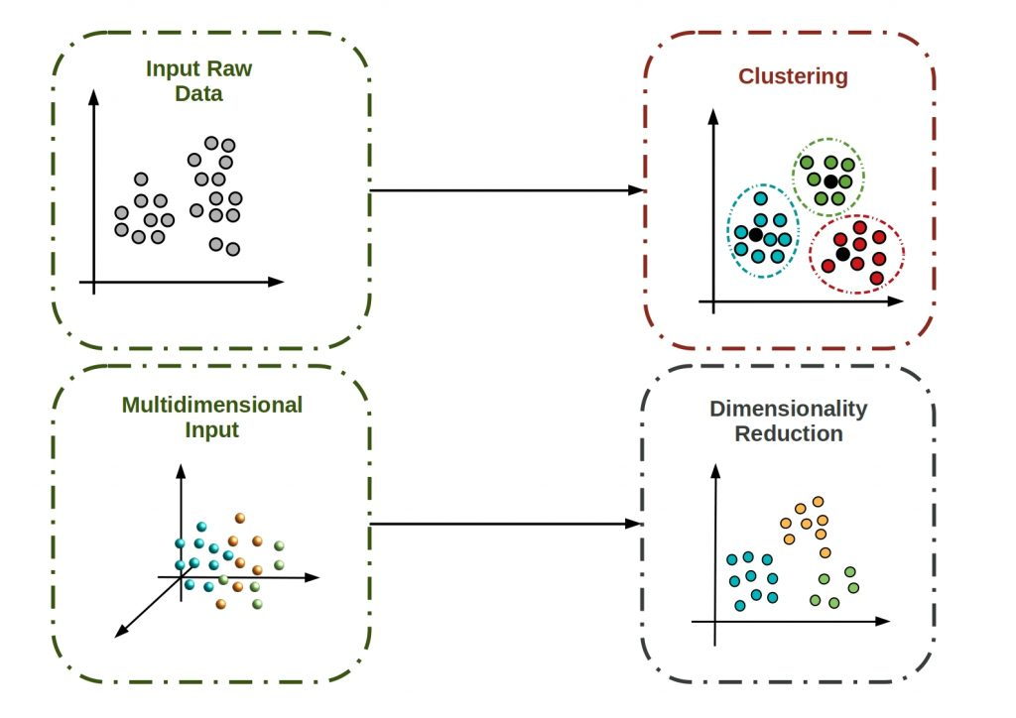
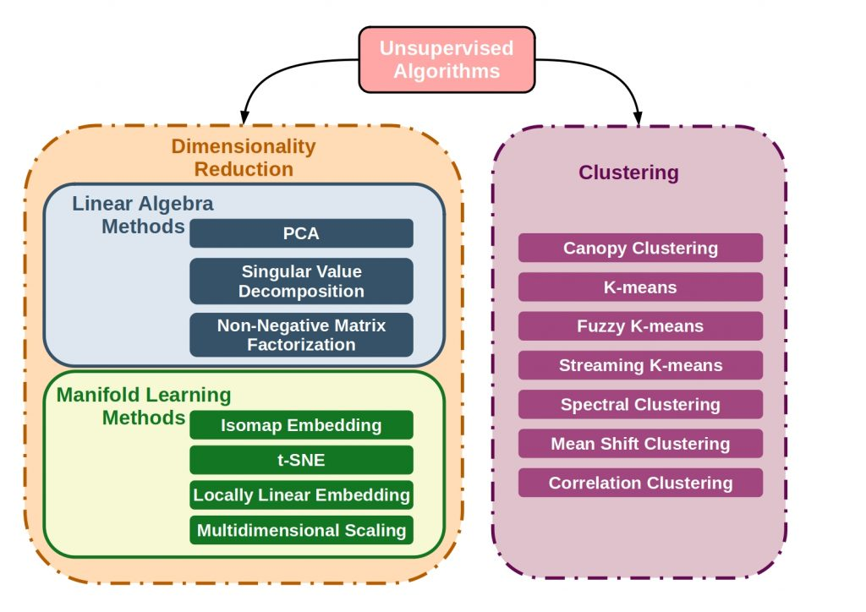
Unsupervised Learning

Slide 11
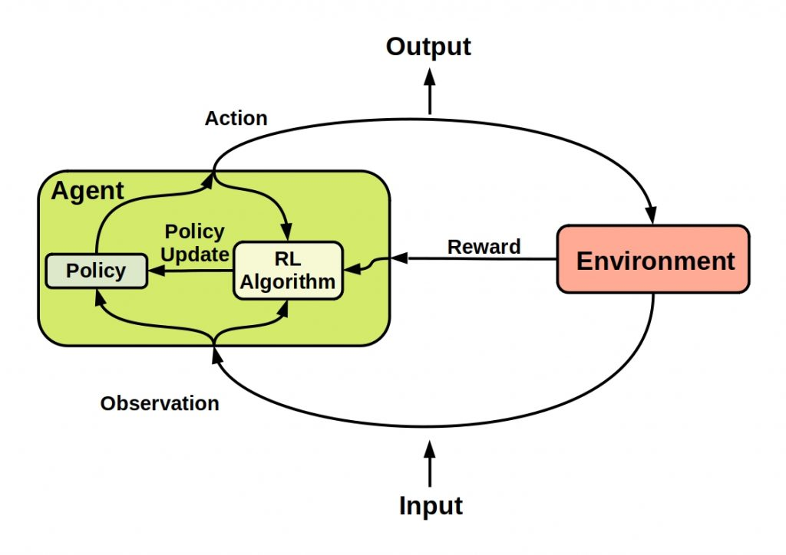
Reinforcement Learning

Slide 12
Supervised Learning
Unsupervised Learning
Reinforcement Learning
Definition | It is a method in which we teach the machine using labelled data. | Here, the machine is trained on unlabelled data without any guidance. | In this approach, an agent interacts with its environment by producing actions and discovers errors or rewards.
Type of Problems | Classification, Regression | Association, Clustering | Reach a certain state (goal)
Type of Data | Labelled Data | Unlabelled data | No Predefined Data
Training | External Supervision | No Supervision | No Supervision or Clue
Aim | Forecast Outcomes | Unleashing the underlying patterns | Learn series of action
Approach | Mapping labelled input to known output | Understand patterns and discover output | Follow Trail and Error method
Output Feedback | Direct Feedback | No Feedback | Reward System
Popular Algorithms | Linear regression, Logistic Regression, SVM, KNN, Random Forest | K-Means, Apriori, C-Means | Q-Learning, SARSA
Applications | Risk Evaluation, Forecast Sales | Anomaly Detection, Recommendation Systems | Self Driving Cars, Gaming

Slide 13
3. Use Cases - Machine Learning

Slide 14
Artificial intelligence (AI) developments for applications like computer vision (CV) and natural language processing (NLP) are assisting sectors like financial services, healthcare, and automotive to speed innovation, enhance customer experience, and save costs.
All sorts of businesses, including manufacturing, retail, healthcare and life sciences, travel and hospitality, financial services, and energy, feedstock, and utilities, can benefit from the use of machine learning. Real world scenarios include…
Manufacturing: Condition monitoring and predictive maintenance
Retail: Marketing across channels and upselling
HealthCare: Identification of diseases and satisfaction of risk
Travel: Adaptive pricing
Finance: Regulation and risk analytics
Energy: Optimization of energy demand and supply

Slide 15
Problem Statements…
Study a bank credit dataset of customers and make a decision about whether to approve or deny the loan of applicant based on their profile.
Predicting the time to reach home from office based on the climate data, speed of the vehicle, routes taken to reach the address.
Recommend set of medicines based on the previous health history of the patient based on the health conditions.
Improving Sales of a firm by performing Market based analysis
Reach a destination from different locations in your Tesla
Notes:
KNN Algorithm
Regression - Polynomial
K-means Algorithm
Association rule mining & Apriori Algorithm
Q-Learning

Slide 16
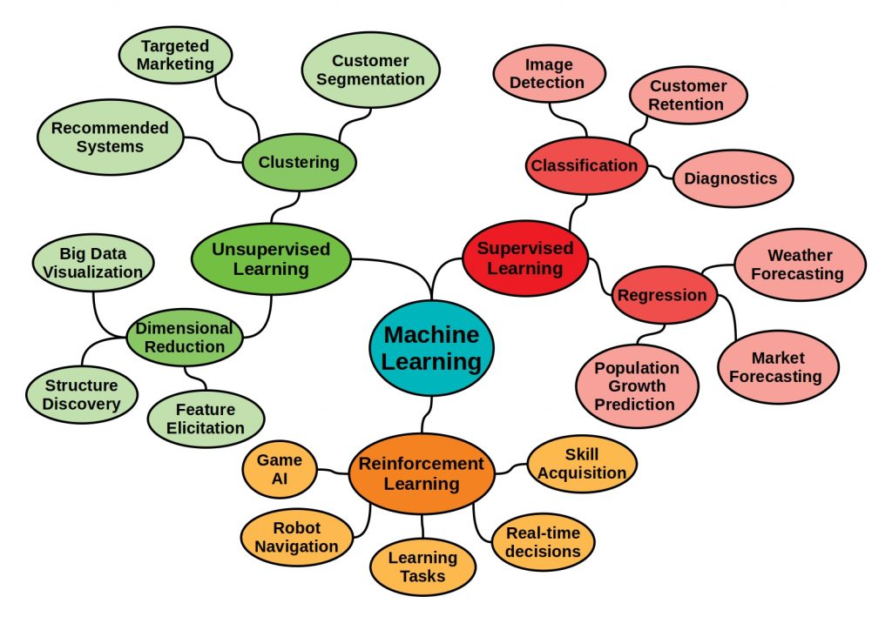

Slide 17
2022: ML is in almost every aspect of our lives
Machine Translation
Photo editing
Face
unlocking
Recommendation
Fraud detection
ETA
Search
Self driving cars
AI assistant
Smart compose
Smart security cameras

Slide 18
Why ML Systems Design?
ML algorithms is the less problematic part.
The hard part is to how to make algorithms work with other parts to solve real-world problems.

Slide 19
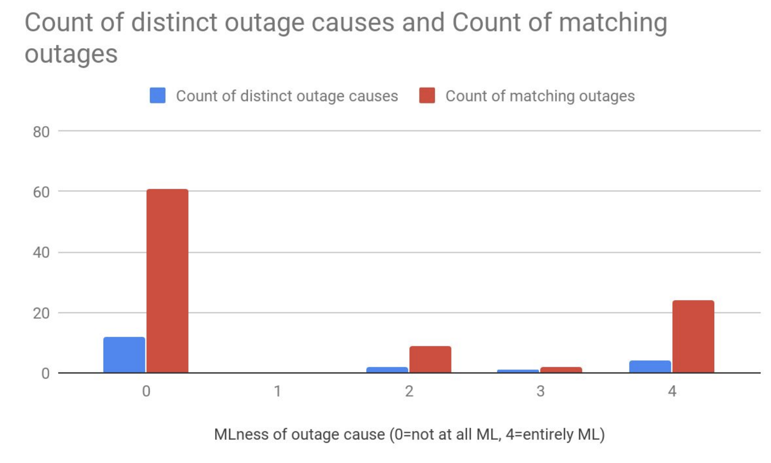
Why ML Systems Design?
ML algorithms is the less problematic part.
The hard part is to how to make algorithms work with other parts to solve real-world problems.
60/96 failures caused by non-ML components

Slide 20
Today’s Topic
System
Interface
Data
ML algorithms
Infrastructure
Most ML courses/books
Hardware

Slide 21
What’s machine learning systems design?
The process of defining the interface, algorithms, data, infrastructure, and hardware for a machine learning system to satisfy specified requirements.

Slide 22
What’s machine learning systems design?
The process of defining the interface, algorithms, data, infrastructure, and hardware for a machine learning system to satisfy specified requirements.
reliable, scalable, maintainable, adaptable

Slide 23
4. ML research vs. ML production

Slide 24
ML research vs. ML production
 | Research | Production
Objectives | Model performance* | Different stakeholders have different objectives

Slide 25


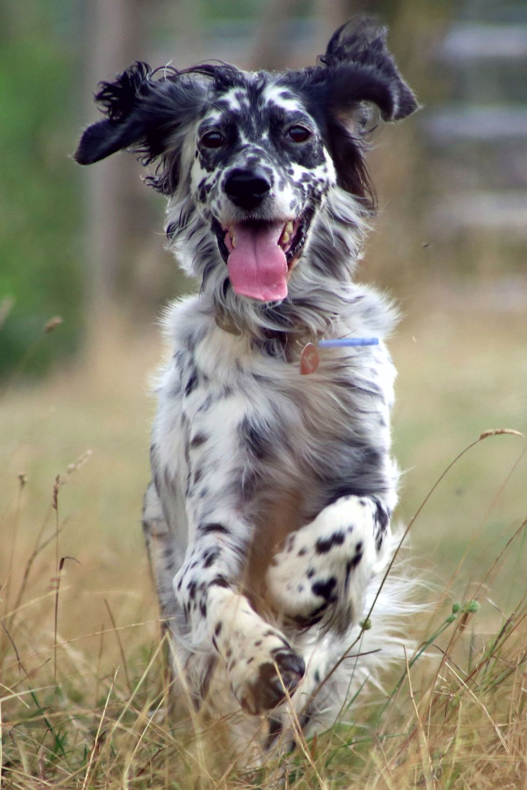
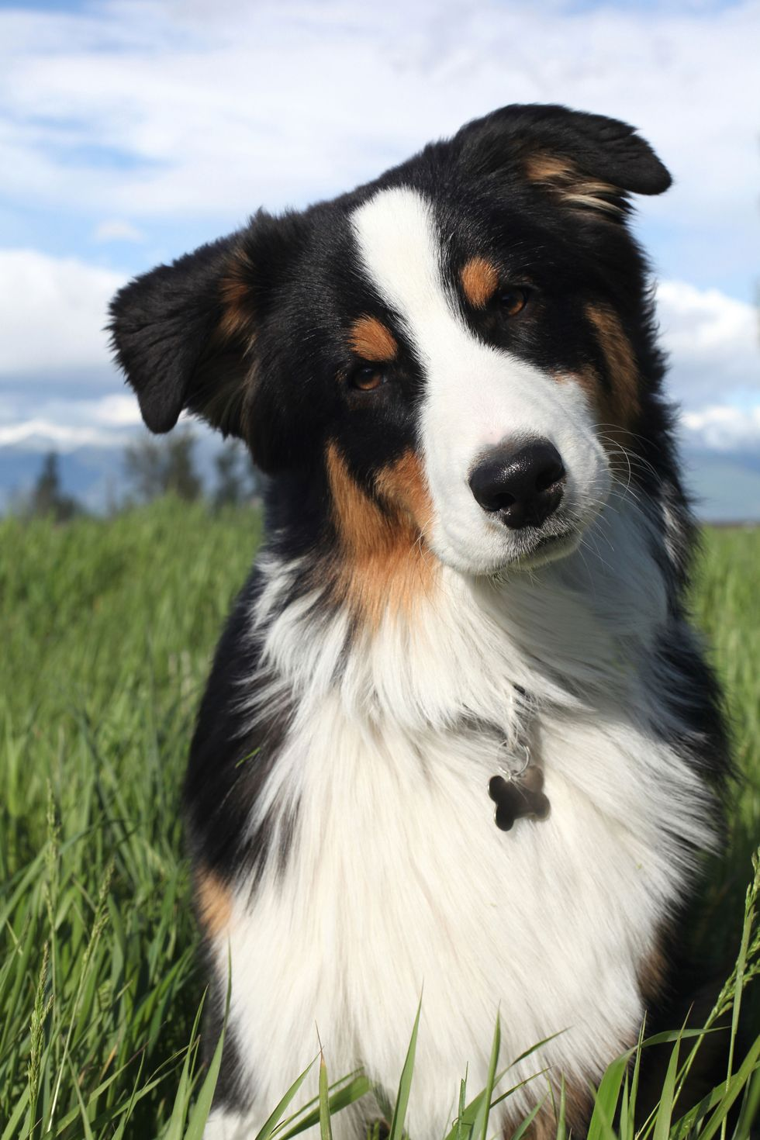
Stakeholder objectives
ML team
highest accuracy
Sales
sells more ads
Product
fastest inference
Manager
maximizes profit
= laying off ML teams

Slide 26
Computational priority
 | Research | Production
Objectives | Model performance | Different stakeholders have different objectives
Computational priority | Fast training, high throughput | Fast inference, low latency
generating predictions

Slide 27


Latency: time to move a leaf
Throughput: how many leaves in 1 sec

Slide 28
Real-time: low latency = high throughput
Batched: high latency, high throughput

Slide 29
ML in research vs. in production
 | Research | Production
Objectives | Model performance | Different stakeholders have different objectives
Computational priority | Fast training, high throughput | Fast inference, low latency
Data | Static | Constantly shifting

Slide 30
Data
Research | Production
Clean Static Mostly historical data | Messy Constantly shifting Historical + streaming data Biased, and you don’t know how biased Privacy + regulatory concerns

Slide 31
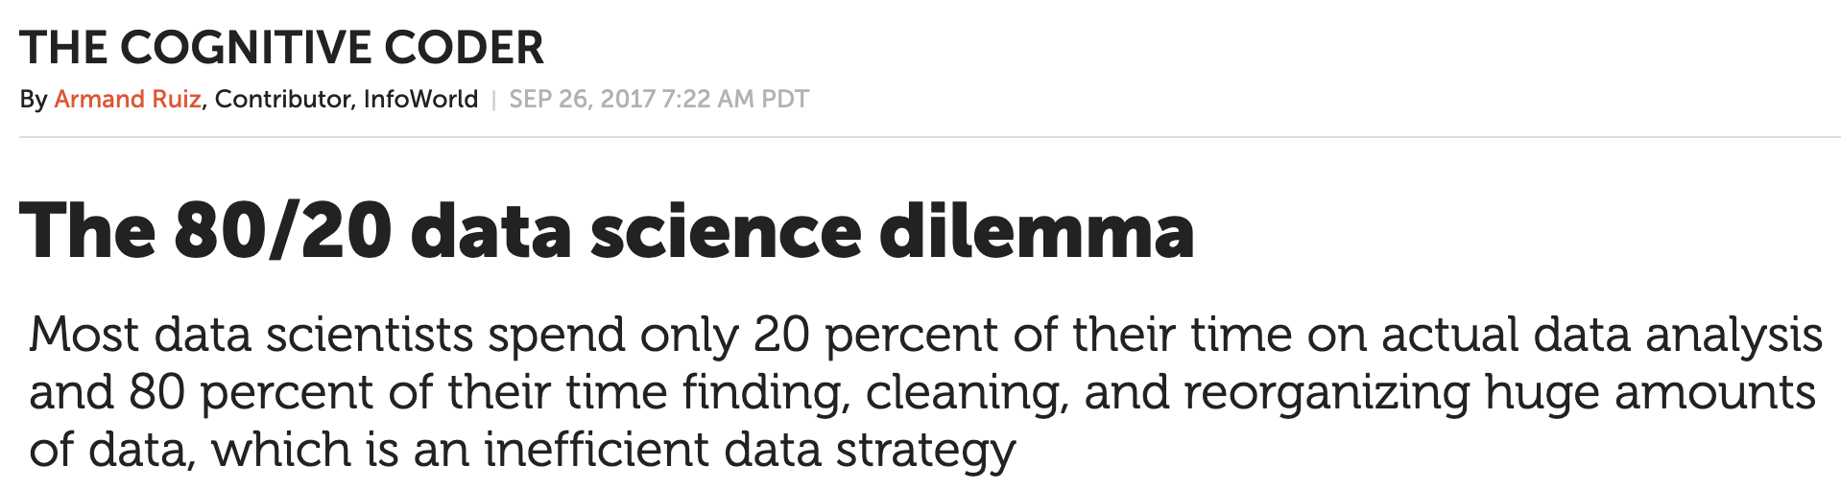

Slide 32
ML in research vs. in production
 | Research | Production
Objectives | Model performance | Different stakeholders have different objectives
Computational priority | Fast training, high throughput | Fast inference, low latency
Data | Static | Constantly shifting
Interpretability* | Good to have | Important

Slide 33
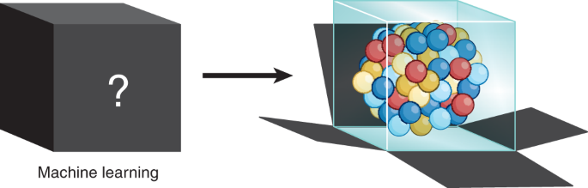
Interpretability
Suppose you have cancer and you have to choose between a blackbox AI surgeon that cannot explain how it works but has 90% cure rate and a human surgeon with 80% cure rate.
Do you want the AI surgeon or human surgeon?

Slide 34
ML in research vs. in production
 | Research | Production
Objectives | Model performance | Different stakeholders have different objectives
Computational priority | Fast training, high throughput | Fast inference, low latency
Data | Static | Constantly shifting
Interpretability | Good to have | Important

Slide 35
5. ML systems vs. traditional software

Slide 36

Traditional software
Separation of Concerns is a design principle for separating a computer program into distinct sections such that each section addresses a separate concern
Code and data are separate
Inputs into the system shouldn’t change the underlying code

Slide 37
ML systems
Code and data are tightly coupled
ML systems are part code, part data
Not only test and version code, need to test and version data too
the hard part

Slide 38
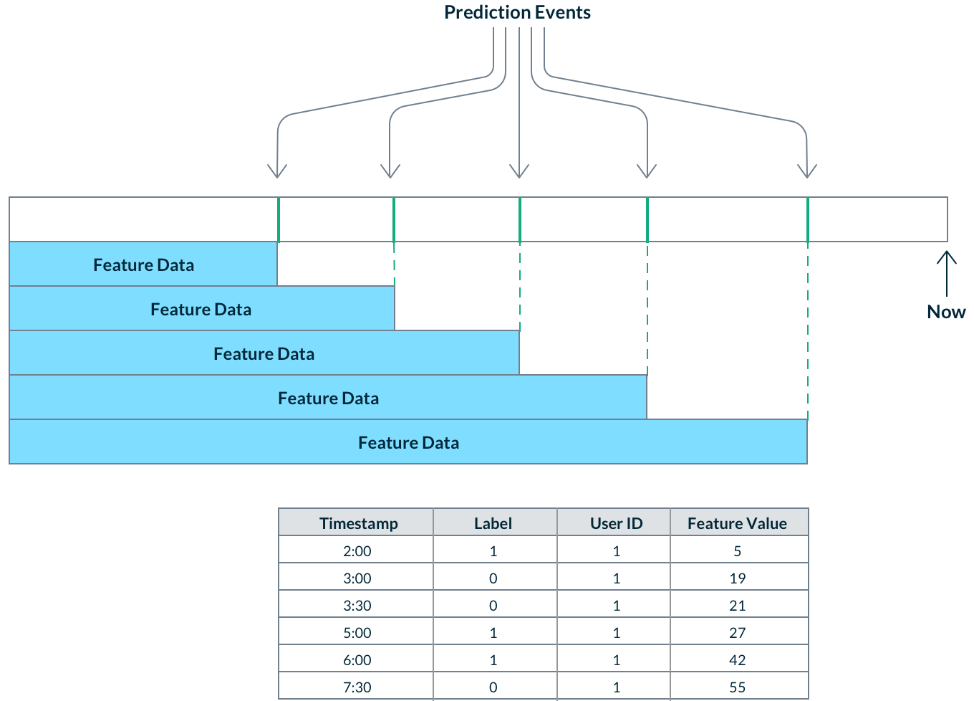
Test and version data
Extremely hard to ensure correctness in time

Slide 39
How to …
Validate data correctness?
Test features’ usefulness?
Detect when the underlying data distribution has changed?
Know if the changes are bad for models without ground truth labels?
Detect malicious data?
Not all data points are equal (e.g. scans of cancerous lungs are more valuable)
Bad data might harm your model and/or make it susceptible to attacks

Slide 40
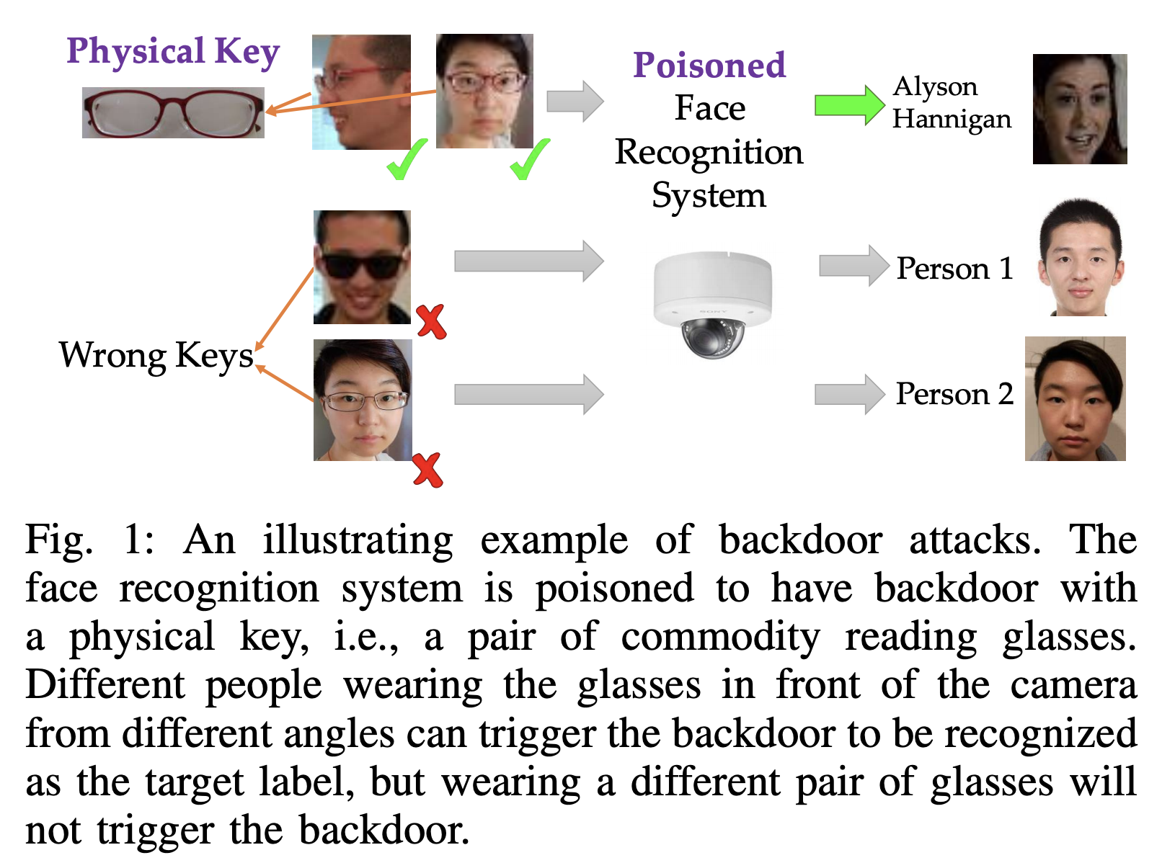
ML systems: data poisoning attacks

Slide 41
Engineering challenges with large ML models
Too big to fit on-device
Consume too much energy to work on-device
Too slow to be useful
Autocompletion is useless if it takes longer to make a prediction than to type
If unit/CI tests take hours, the development cycles will stagnate

Slide 42
6. ML production myths

Slide 43
Myth #1: Deploying is hard
Deploying is easy. Deploying reliably is hard

Slide 44
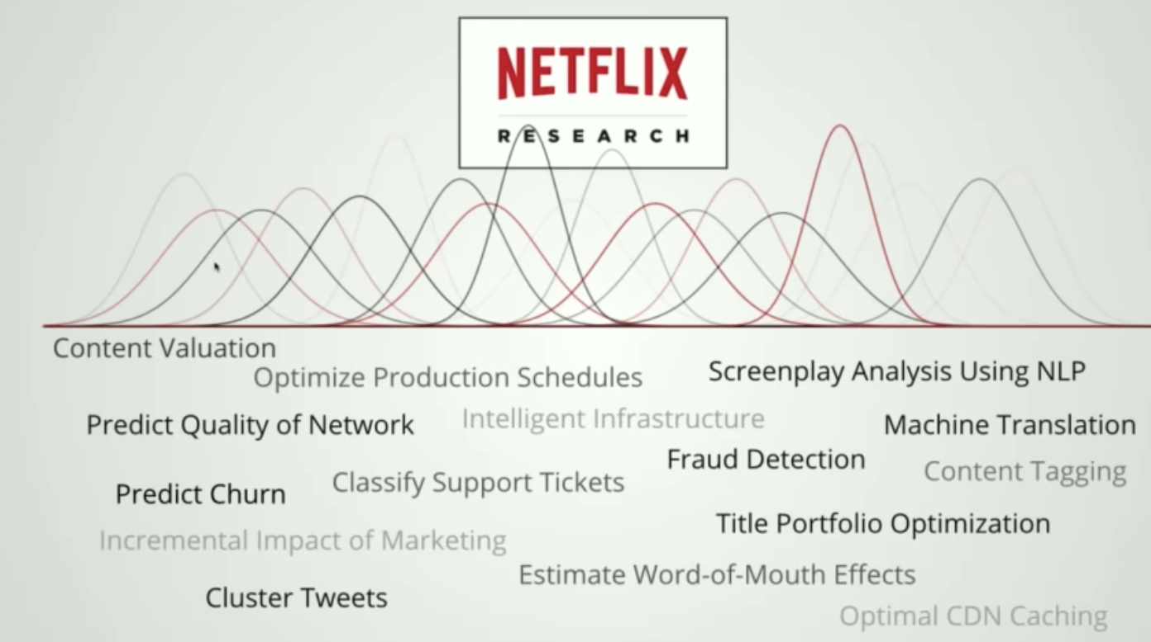
Myth #2: You only deploy one or two ML models at a time
Booking.com: 150+ models, Uber: thousands

Slide 45
Myth #3: You won’t need to update your models as much
Notes:
How often should I update my model?

Slide 46
DevOps: Pace of software delivery is accelerating
Elite performers deploy 973x more frequently with 6570x faster lead time to deploy (Google DevOps Report, 2021)
DevOps standard (2015)
Etsy deployed 50 times/day
Netflix 1000s times/day
AWS every 11.7 seconds

Slide 47
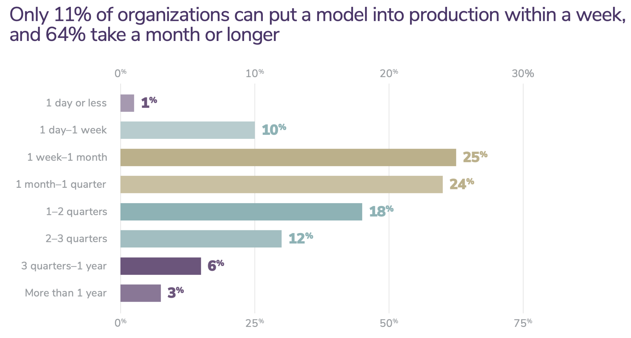
DevOps to MLOps: Slow vs. Fast
Image from Algorithmia | Right image: Machine learning with Flink in Weibo (Qian Yu, QCon 2019)

Slide 48
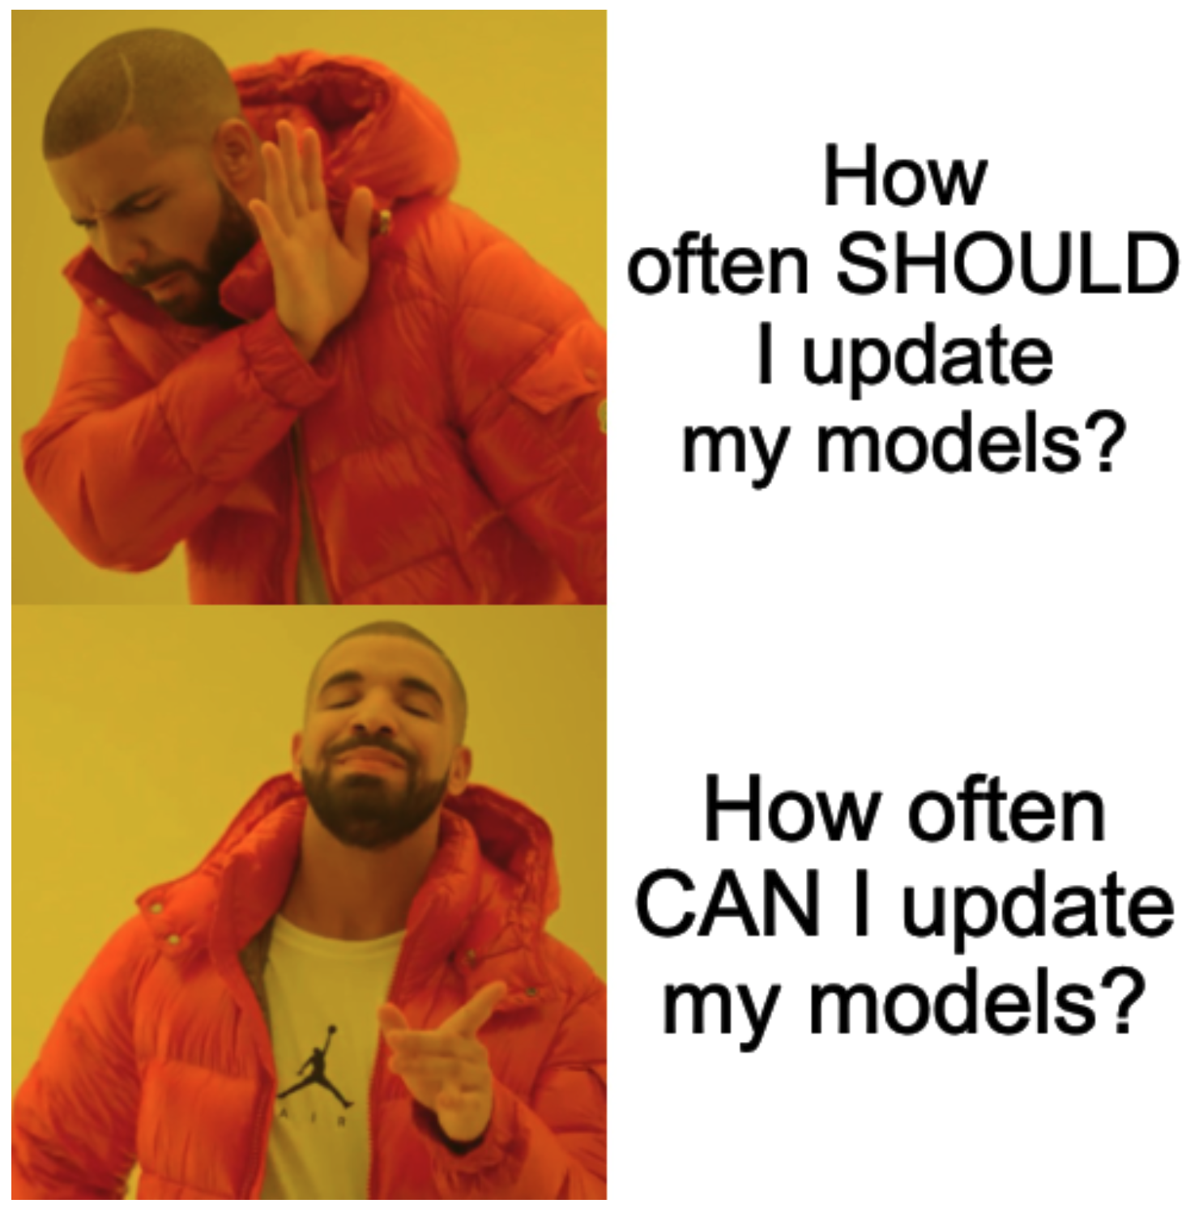
Accelerating ML Delivery

Slide 49

ML + DevOps =
Notes:
Apply DevOps techniques to ML

Slide 50
Myth #4: ML can magically transform your business overnight
Magically: possible
Overnight: no

Slide 51
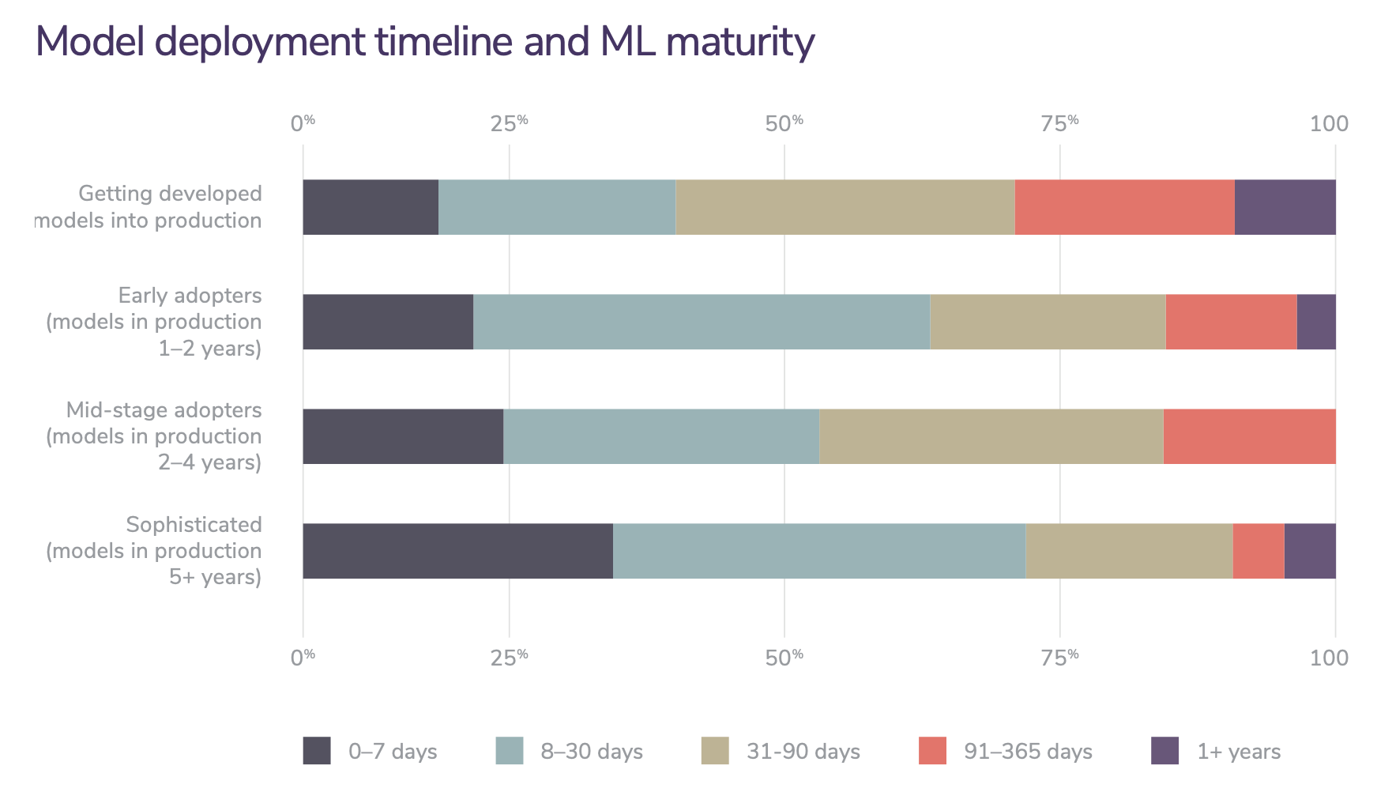
Efficiency improves with maturity
2020 state of enterprise machine learning (Algorithmia, 2020)

Slide 52
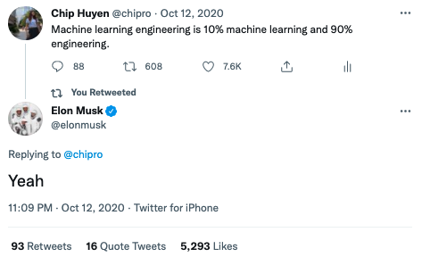
ML engineering is more engineering than ML
MLEs might spend most of their time:
wrangling data
understanding data
setting up infrastructure
deploying models
instead of training ML models

Slide 53
Myth #5: Most ML engineers don’t need to worry about scale

Slide 54
7. ML Systems Fundamentals

Slide 55

ML in production: expectation
Collect data
Train model
Deploy model

Slide 56
ML in production: reality
Choose a metric to optimize
Collect data
Train model
Realize many labels are wrong -> relabel data
Train model
Model performs poorly on one class -> collect more data for that class
Train model
Model performs poorly on most recent data -> collect more recent data
Train model
Deploy model
Dream about $$$
Wake up at 2am to complaints that model biases against one group -> revert to older version
Get more data, train more, do more testing
Deploy model
Pray
Model performs well but revenue decreasing
Cry
Choose a different metric
Start over
Step 15 and 17 are essential

Slide 57
Project considerations
Framing
Objectives
Constraints
Phases

Slide 58
Framing the problem
Task type
Regression
Classification
Binary
Multiclass
Multilabel
Low cardinality
High cardinality

Slide 59
Multiclass vs. multilabel
Task type
Regression
Classification
Binary
Multiclass
Multilabel
0 | 0 | 0 | 1
0 | 1 | 0 | 1
A label can belong to only one class
A label can belong to multiple classes

Slide 60
How to handle multilabel tasks
Multilabel problem solution
A multiclass problem
A set of multiple binary problems
0 | 1 | 0 | 1
Model 1: Does this belong to class 1?
Model 2: Does this belong to class 2?
…

Slide 61
Multilabel is harder than multiclass
Multilabel problem solution
How to create ground truth labels?
How to decide decision boundaries
A multiclass problem
A set of multiple binary problems
0 | 1 | 0 | 1
Model 1: Does this belong to class 1?
Model 2: Does this belong to class 2?
…

Slide 62
A problem can be framed as different task types
Problem: predict the app users will most likely open next
Classification
INPUT
0.072 | 0.15 | … | … | 0.067 | 0.154
User’s features
Environment time, location, etc.
App 0
0.2
0.02
…
0.04
OUTPUT
App 1
…

Slide 63
A problem can be framed as different task types
Problem: predict the app users will most likely open next
Classification
INPUT
0.072 | 0.15 | … | … | 0.067 | 0.154
⚠ Every time an app is added/removed, you have to retrain your model ⚠
User’s features
Environment time, location, etc.
App 0
0.2
0.02
…
0.04
OUTPUT
App 1
…

Slide 64
Framing can make the problem easier/harder
Very common framing for recommendations / ads CTR
Problem: predict the app users will most likely open next
Regression
OUTPUT
INPUT 0
0.072 | 0.15 | … | … | 0.067 | 0.154
0.03
App 0
User’s features
Environment time, location, etc.
App’s features
INPUT 1
0.072 | 0.15 | … | … | 0.067 | 0.154
0.06
App 1
INPUT …
0.072 | 0.15 | … | … | 0.067 | 0.154
0.25
App …

Slide 65
Project objectives
ML objectives
Business objectives

Slide 66
Project objectives
ML objectives
Performance
Latency
etc.
How to evaluate accuracy/F1/etc. without ground truth labels?

Slide 67
Project objectives
ML objectives
Performance
Latency
etc.
Business objectives
Cost
ROI
Regulation & compliance

Slide 68

Project objectives
ML objectives
Performance
Latency
etc.
Business objectives
Cost
ROI
Regulation & compliance

Slide 69
Business objectives
How can this ML project increase profits directly or indirectly?
Directly: increasing sales (ads, conversion rates), cutting costs
Indirectly: increasing customer satisfaction, increasing time spent on a website

Slide 70
ML <-> business: can be tricky
ML model gives customers more personalized solutions
customers’ problems solved faster
customers happier
customers spending more money
customers spending less money

Slide 71
ML <-> business: mapping
Baselines
Existing solutions, simple solutions, human experts, competitors solutions, etc.
Usefulness threshold
Self-driving needs human-level performance. Predictive texting doesn’t.
False negatives vs. false positives
Covid screening: no false negative (patients with covid shouldn’t be classified as no covid)
Fingerprint unlocking: no false positive (unauthorized people shouldn’t be given access)
Interpretability
Does it need to be interpretable? If yes, to whom?
Confidence measurement (how confident it is about a prediction)
Does it need confidence measurement?
Is there a confidence threshold? What to do with predictions below that threshold—discard it, loop in humans, or ask for more information from users?

Slide 72
Constraints: time & budget
Time
Rule of thumb: 20% time to get initial working system, 80% on iterative development
Budget
Data, resources, talent
Time/budget tradeoffs
Use more (powerful) machines
Hire more people to label data faster
Run more experiments in parallel
Buy existing solutions

Slide 73
Constraints: privacy
Annotation
Can data be shipped outside organizations for annotation?
Storage
What kind of data are you allowed to store? How long can you store it?
Third-party solutions
Can you share your data with a 3rd party (e.g. managed service)?
Regulations
What regulations do you have to conform to?

Slide 74
Technical constraints
Competitors
Legacy systems
Notes:
Only Problem with bigger companies - more existing tools, slow in adopting new tools. No legacy system - fresh ML, but if there’s existing system you have to prove ML is better, a hurdle that the original system never had to overcome.

Slide 75
Four phases of ML adoption

Slide 76
Phase 1: Before ML
“If you think that machine learning will give you a 100% boost, then a heuristic will get you 50% of the way there.”
Martin Zinkevich, Google

Slide 77
Phase 2: Simplest ML models
Start with a simple model that allows visibility into its working to:
validate hypothesis
validate pipeline

Slide 78
Phase 3: Optimizing simple models
Different objective functions
Feature engineering
More data
Ensembling

Slide 79
Phase 4: Complex ML models

Slide 80

Questions….?
Thank You

